Slide 1

Financial Investment Analysis and Visualization using PySpark and Hive
Big Data and Data Science – Group 19
Ajay Kumar Akula - 11738662
Rasesh Ravula - 11647434
Yuva Raj Jami - 11690083
Jishna Sathvik Vucha - 11658820

Slide 2

Introduction
Motivation:
Now a days investing the funds without knowing the facts will give financial loss so for smart financial decision we are going to analyze the investment data by suing spark and hive, this can helps us to process the large data in very quick time.
This type of analysis will give brief idea about where invetors can invest their money. By visualizing all those in in the format graphs and charts will give better choice. So this project will help people to make decisions very effectively.

Slide 3

Introduction
Significance:
Decision Making: The decisions made with regards to strategies by investors investment data. This gives an idea got better financial performance and market risks in investment.
Identifying Growth Opportunities: This project makes a worthy of attention towards the investment and promotes growth margin for businesses and investors. This takes advantage of commercial opportunities for investors.
Optimizing Resource Allocation: It makes a clear-cut view where more investments are invested with possible growth of investment potential and gets maximum returns on investment in various sectors.

Slide 4

Introduction
Objectives:
Data Preparation.
Analysis and Visualization
Visualize results using charts and graphs.
Country and Sector Exploration.
Finding out the top countries and sectors for investment.
PySpark and Hive Integration.
Using PySpark for data processing.
Hive for querying.

Slide 5
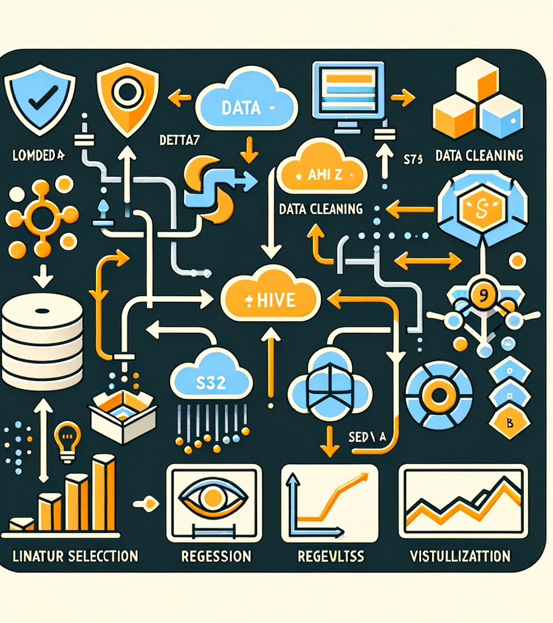
Architecture Diagram
Downloading data to Amazon S3 is the first step in the data processing chain, and a database symbol is shown in the diagram. The "Hive" icon shows how the Hive organizes and locates the data later. The icons for feature selection, data cleaning, and machine learning methods like linear and logistic regression show how PySpark then handles the data. The data is now ready to be analyzed. PySpark makes it easy to interpret results by displaying graphs and charts of the processed data. Finally, the results can be accessed and processed securely because the data is stored in S3.

Slide 6
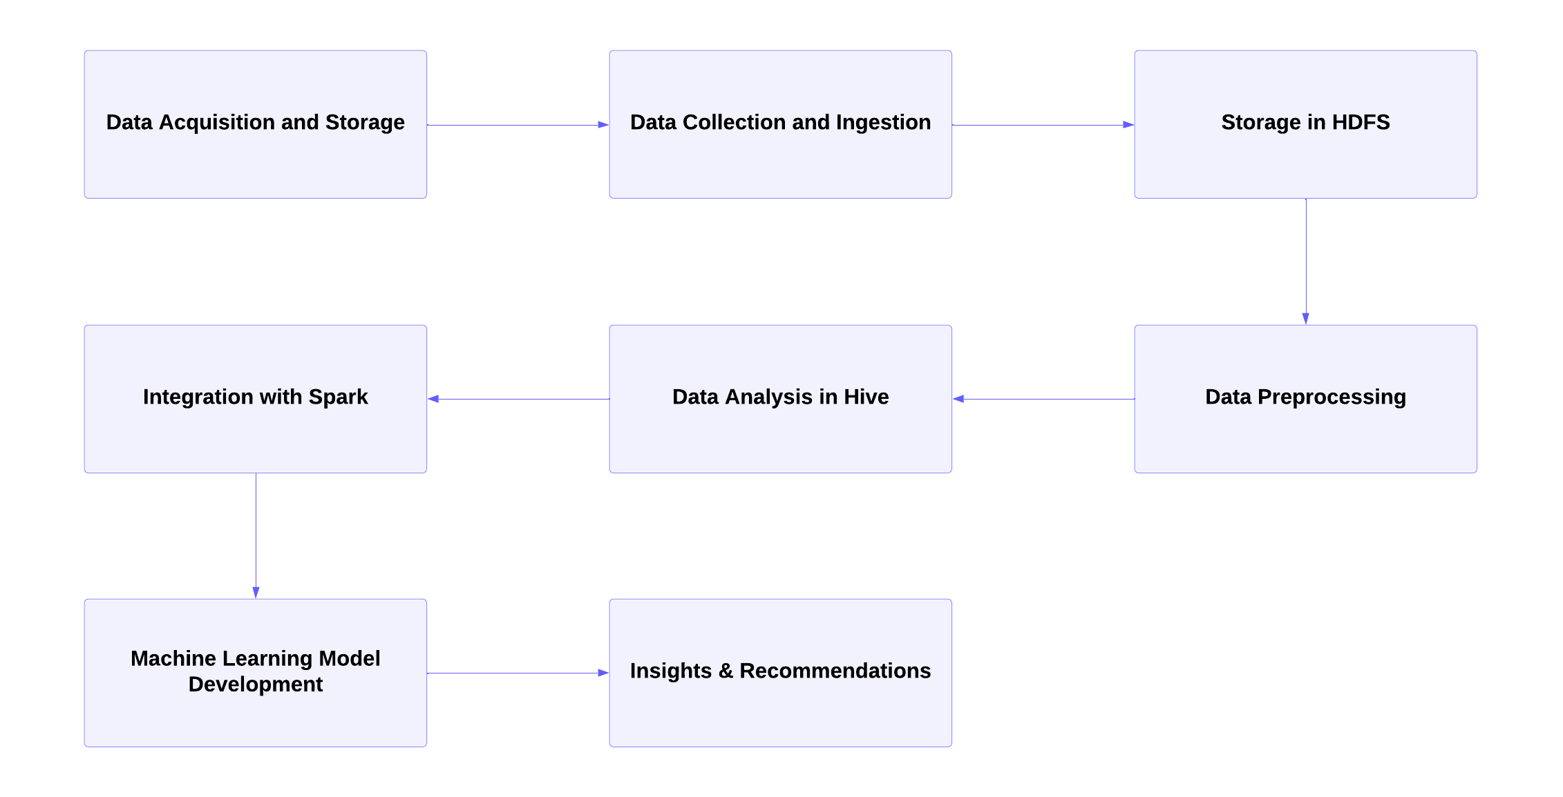
Workflow Diagram

Slide 7
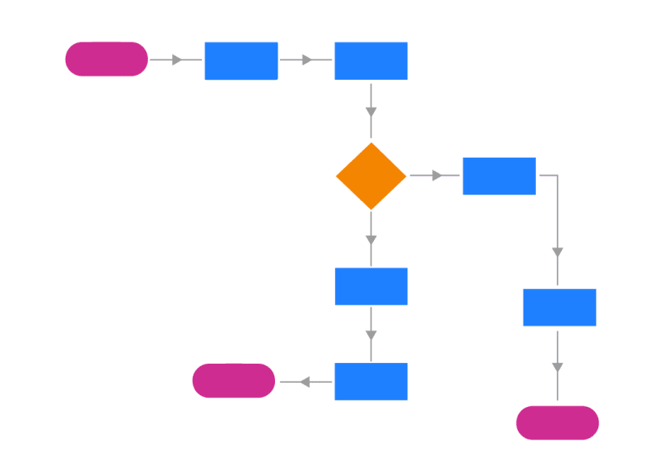
Explanation
The workflow diagram shows a data processing pipeline that includes data science and big data. Elastic MapReduce (EMR) is used to preprocess, cleanse, and analyze data that has already been stored in Amazon S3. The fracture affects S3. A Spark session starts when you connect to the Amazon SageMaker data science unit. Additional data preprocessing and visualization are included in this session. Next, PySpark performs the mathematical prediction tests. The results of the data compilation and visualizations demonstrate how big data processing, storage, and advanced analytics can all be integrated seamlessly in a cloud-based environment

Slide 8
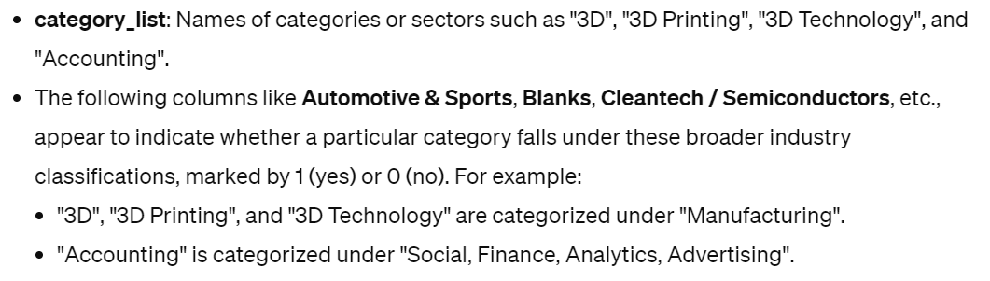
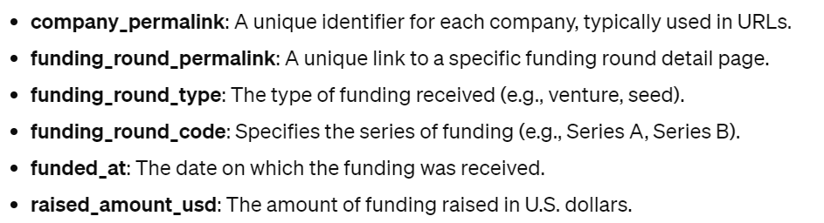
Dataset

Slide 9
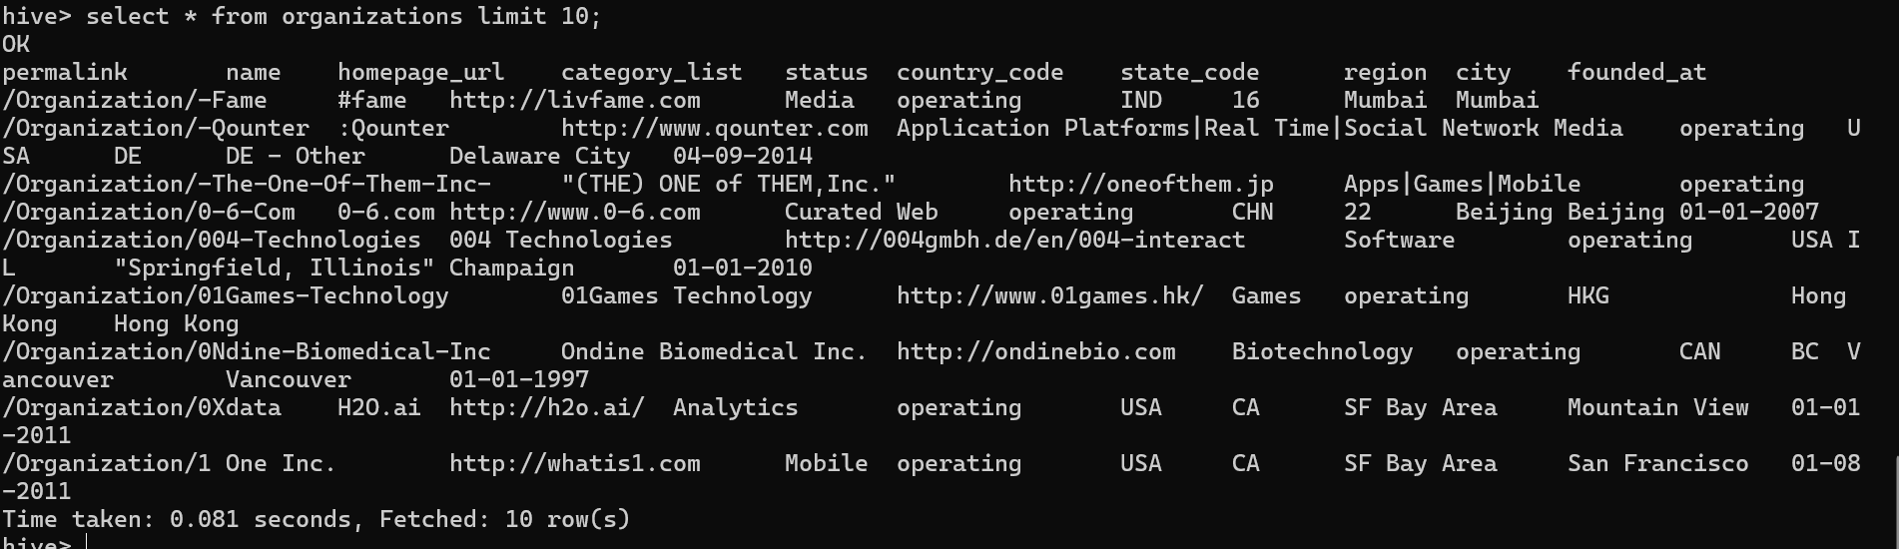
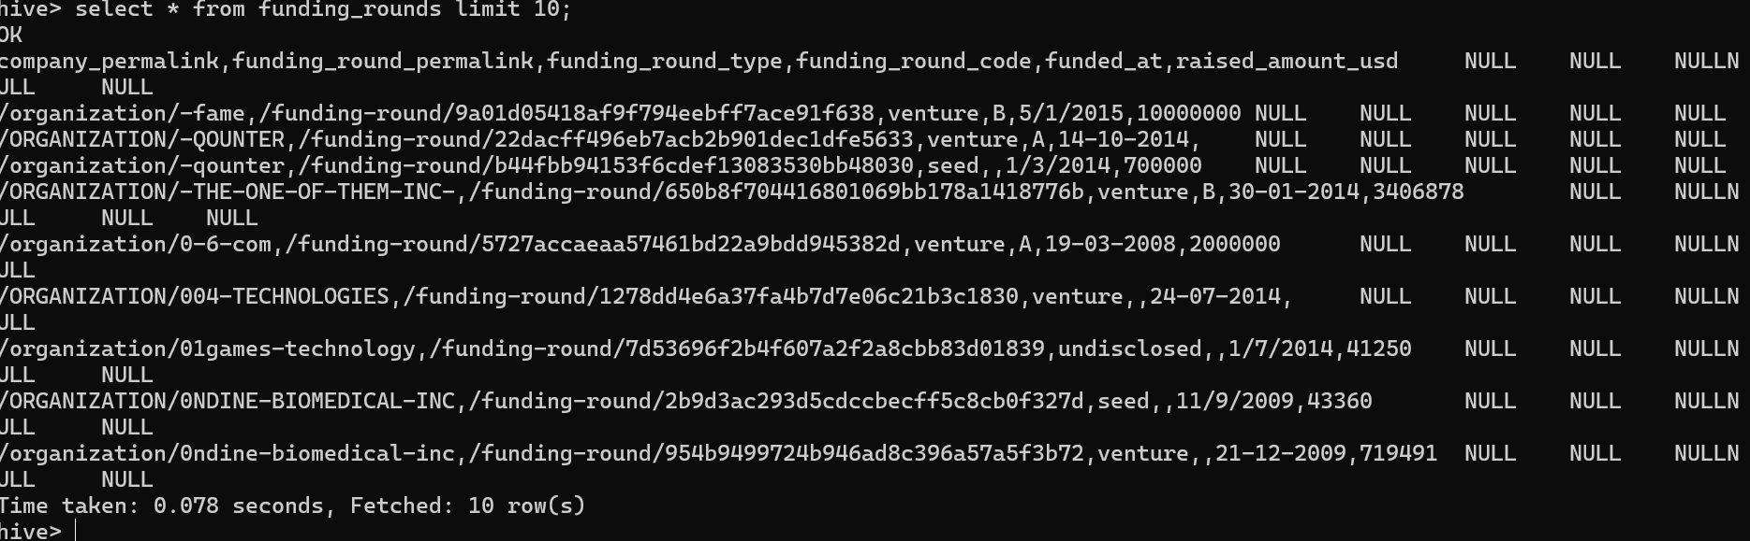
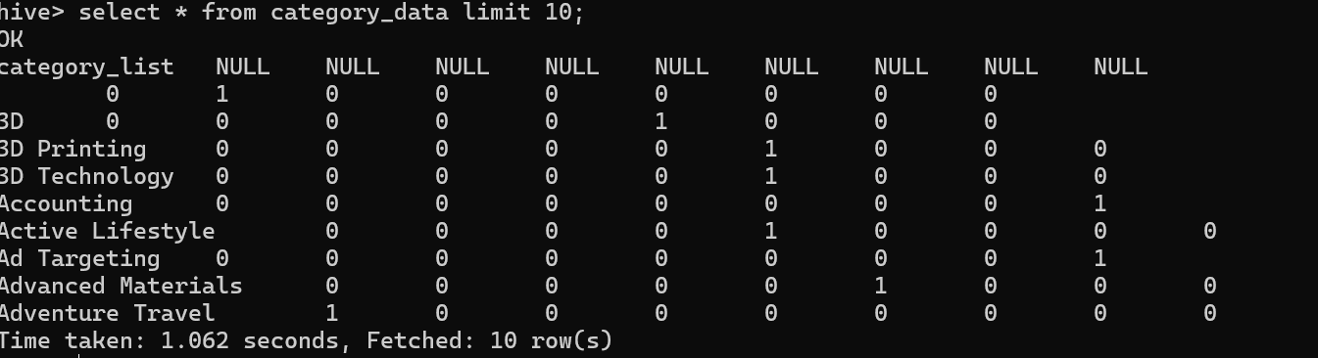
Dataset

Slide 10
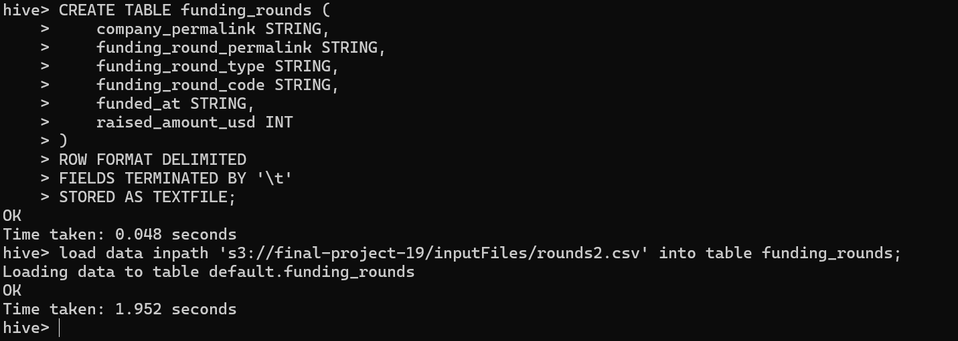
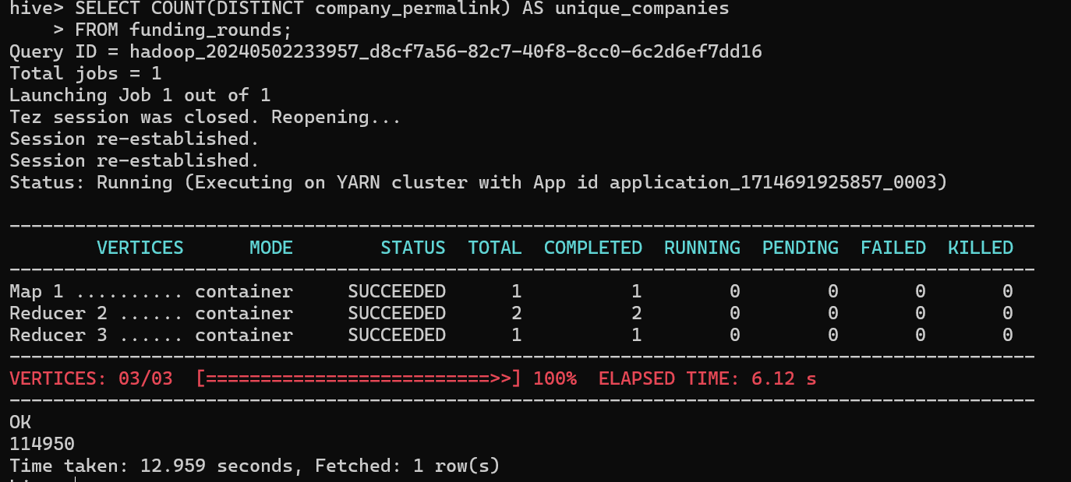
Data Preprocessing
Creating a table only with the necessary columns in Hive
Storing the data in S3

Slide 11
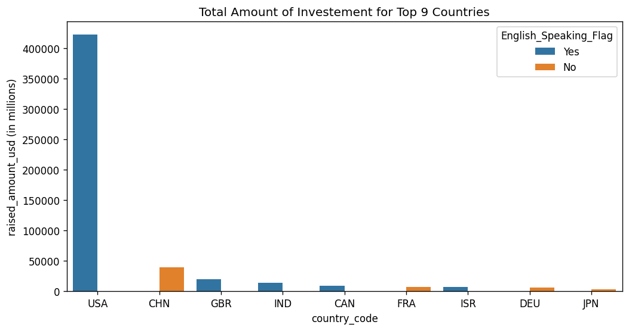
Data Distribution

Slide 12
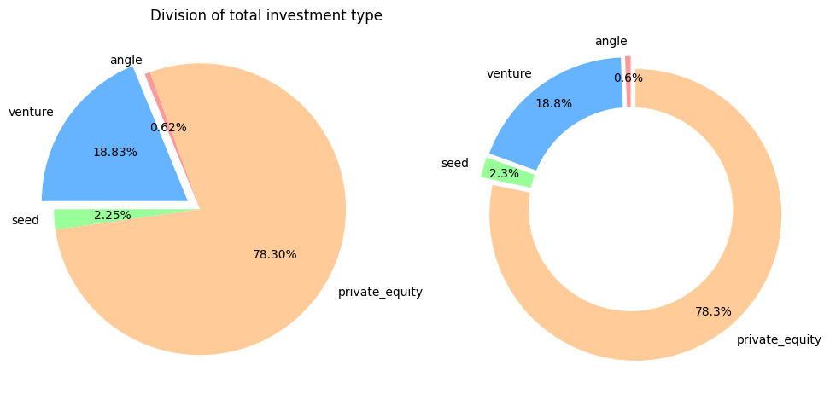
Data Distribution:

Slide 13
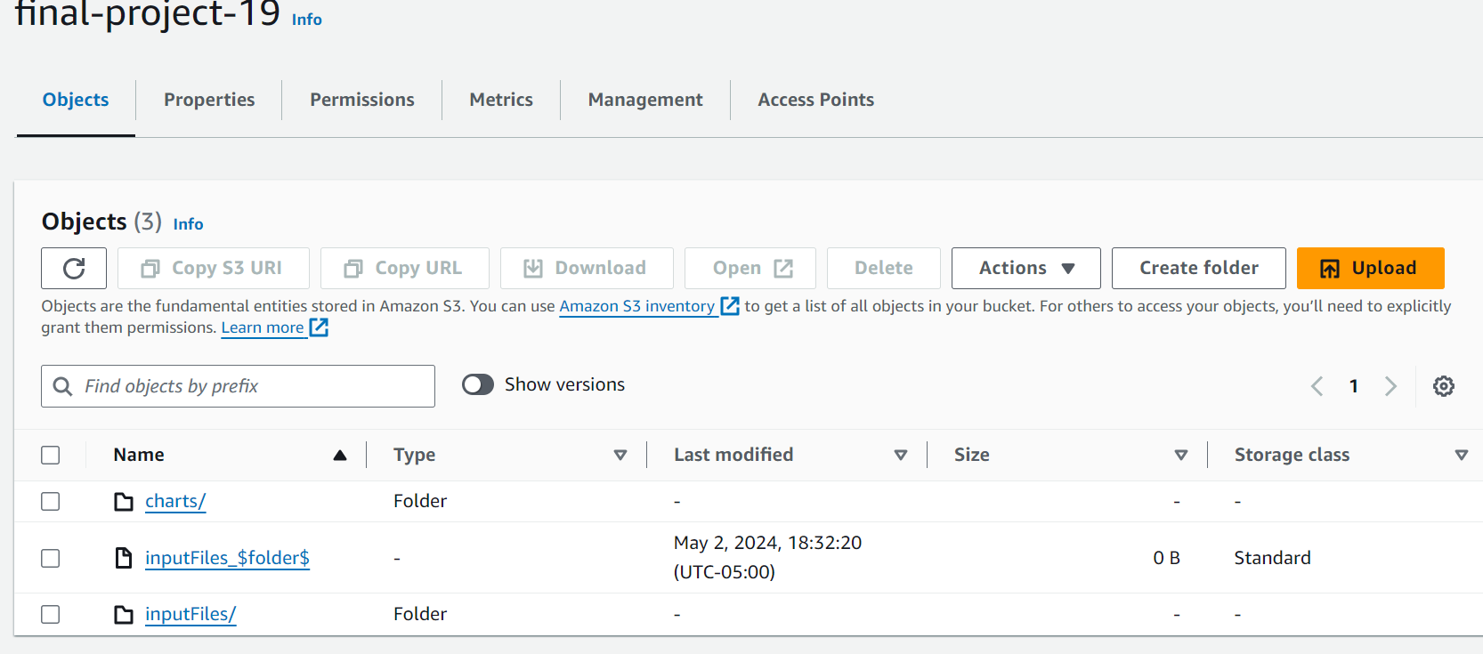
Implementation
Loading the data into S3 storage in the input folder

Slide 14
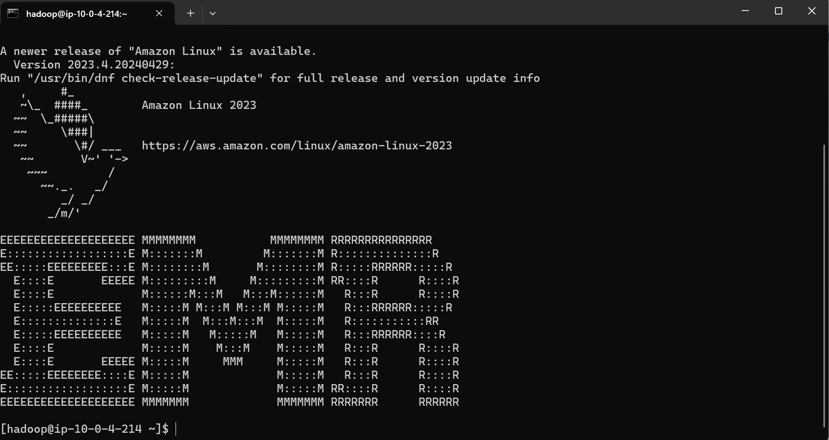
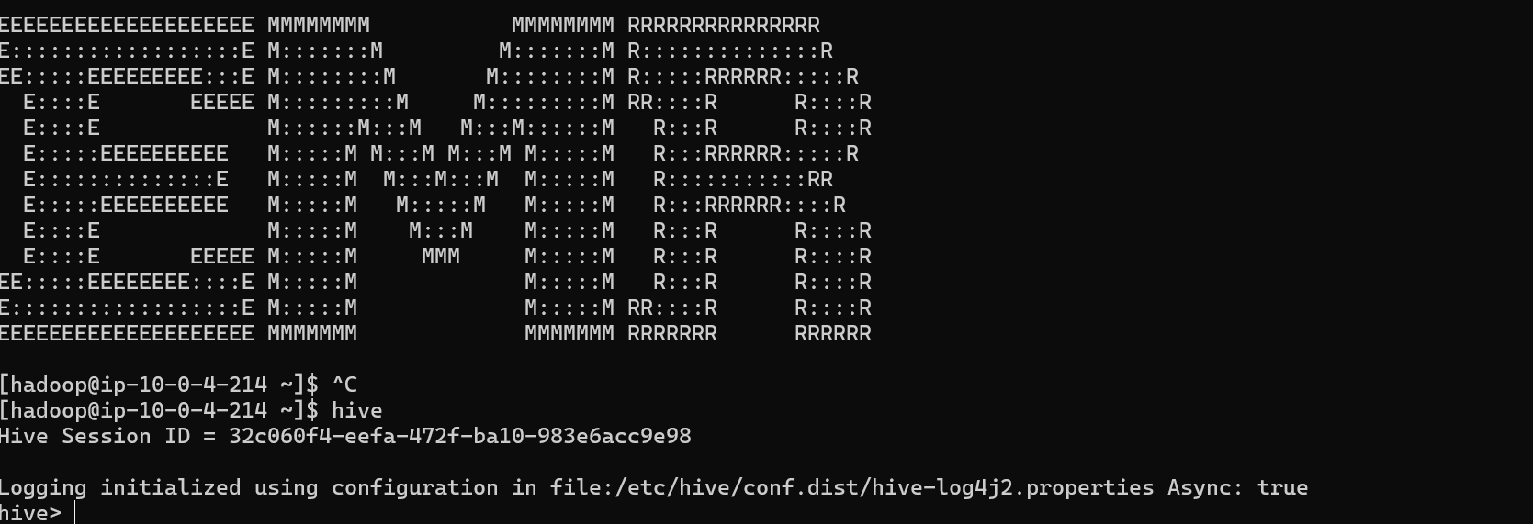
Implementation
Cluster Creation and connecting with Hive:

Slide 15
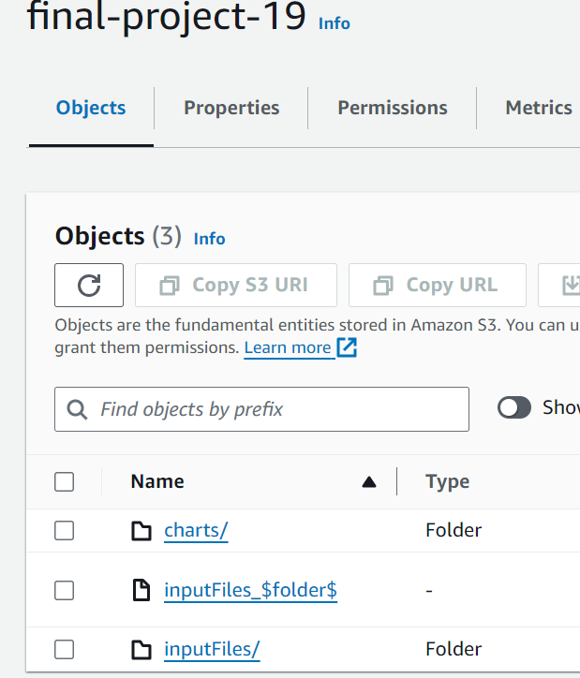
Preprocessed data

Slide 16
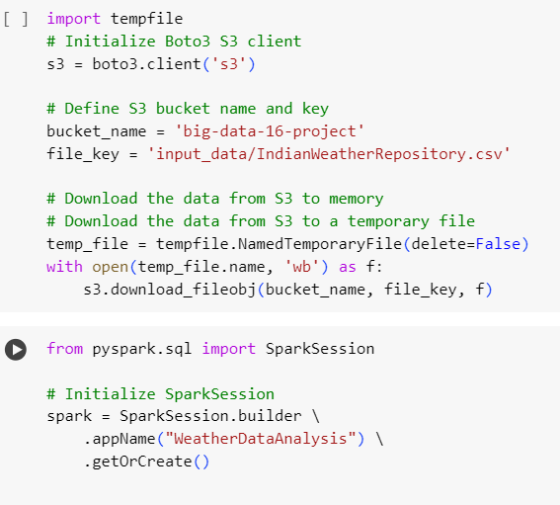
Spark Integration
creating a spark session

Slide 17
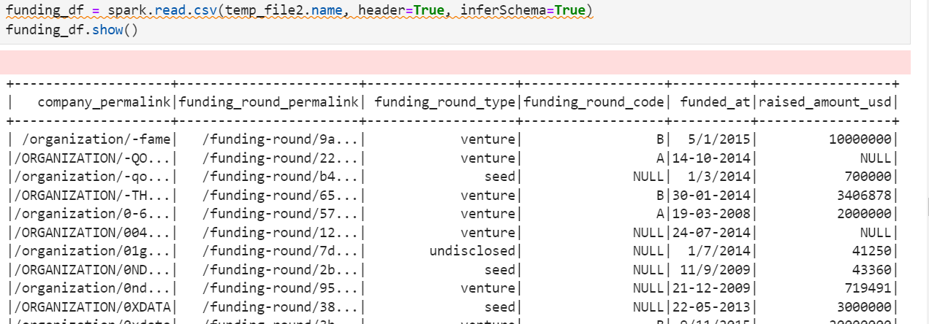
Dataset representation

Slide 18
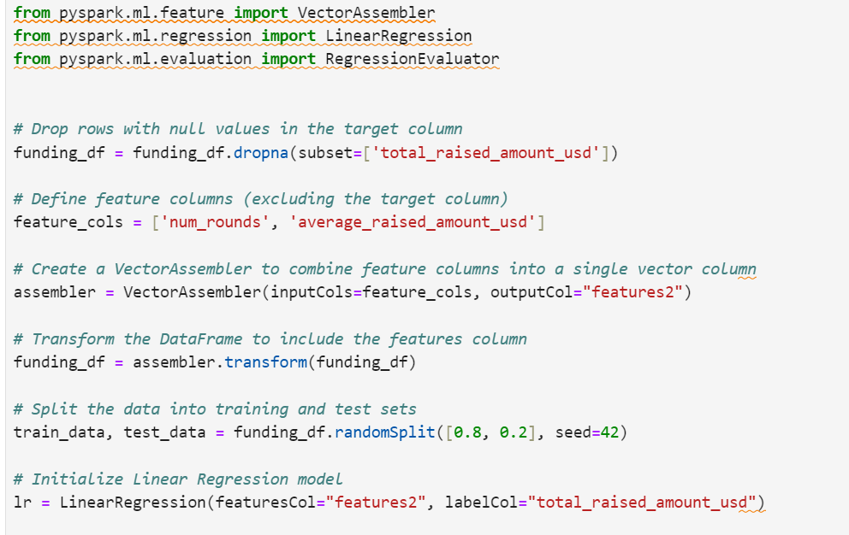
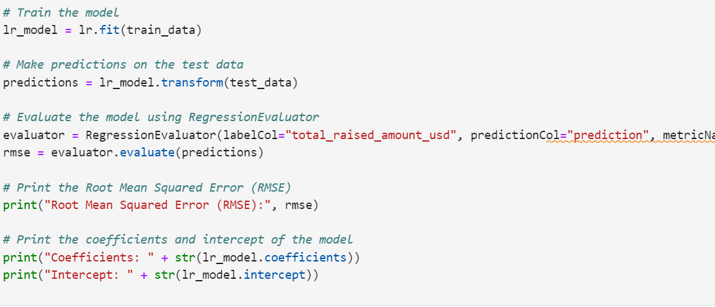
Algorithms

Slide 19
Integration
The project's large financial investment analysis suites are managed by PySpark and Hive. Remote data processing is possible with PySpark, which speeds up the processing of large amounts of data and makes it easier to perform tasks such as feature engineering, data cleaning, and model training across remote clusters. Due to its SQL-like search capabilities, Hive is frequently used to store and manage structured data on HDFS (Hadoop Distributed File System). The integration makes it possible to create predictive models, informative visualizations and detailed research. Last but not least, this helps investors make more effective decisions. This method offers an excellent example.

Slide 20
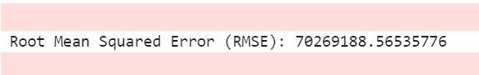
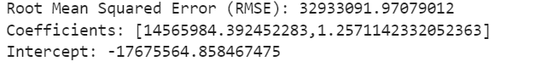
Results

Slide 21
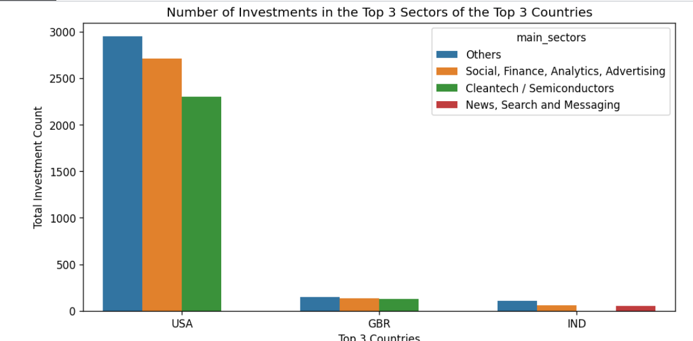
Results

Slide 22

Results
The graph (IND) shows the amount of investments made in the three largest industries: United States, United Kingdom and India. The United States has the following industries: Most financial resources went to “Other,” which is between “Cleantech/Semiconductors” and “Social, Finance, Analytics, Advertising.” Despite a lower investment in the other two, the United Kingdom leads in "Others". On the other hand, in India there are fewer "Cleantech/Semiconductors" categories and more "Other" and "Social, Finance, Analytics, Advertising" categories. Each of the three countries invests little in the "news, search and message" sector.

Slide 23
Project Management
Team Member | Tasks done | Contributions(%)
Ajay Kumar Akula | Research related to dataset and problem identification and analysis and worked on the project flow of the project. | 24
Rasesh Ravula | Worked in analysis the queries related to financial investment using tools like PySpark. | 26
Yuva raj Jami | Worked on building visualization and integration of Hive and PySpark and helped for preprocessing of Machine Learning and worked in documentation work (Pseudo notes and Presentation). | 26
Jishna Sathvik Vucha | Worked on Data Preprocessing and Exploratory data analysis and Model Development. | 24
Concerns: AWS Configuration changed and Faced difficulties in using Pyspark in Sagemaker

Slide 24

References
https://www.researchgate.net/publication/360890442_Applications_of_Big_Data_Analytics_in_Investment_Management_A_Review_and_Future_Research_Agenda_Using_TCM_Framework
https://dl.acm.org/doi/abs/10.4018/JDM.299557
https://docs.aws.amazon.com/whitepapers/latest/big-data-analytics-options/the-aws-advantage-in-big-data-analytics.html
https://www.ijert.org/big-data-analytics-on-aws-cloud
https://ieeexplore.ieee.org/document/9031133

